Slide 1
Exploring Cuisines in Sydney and Melbourne

Slide 2
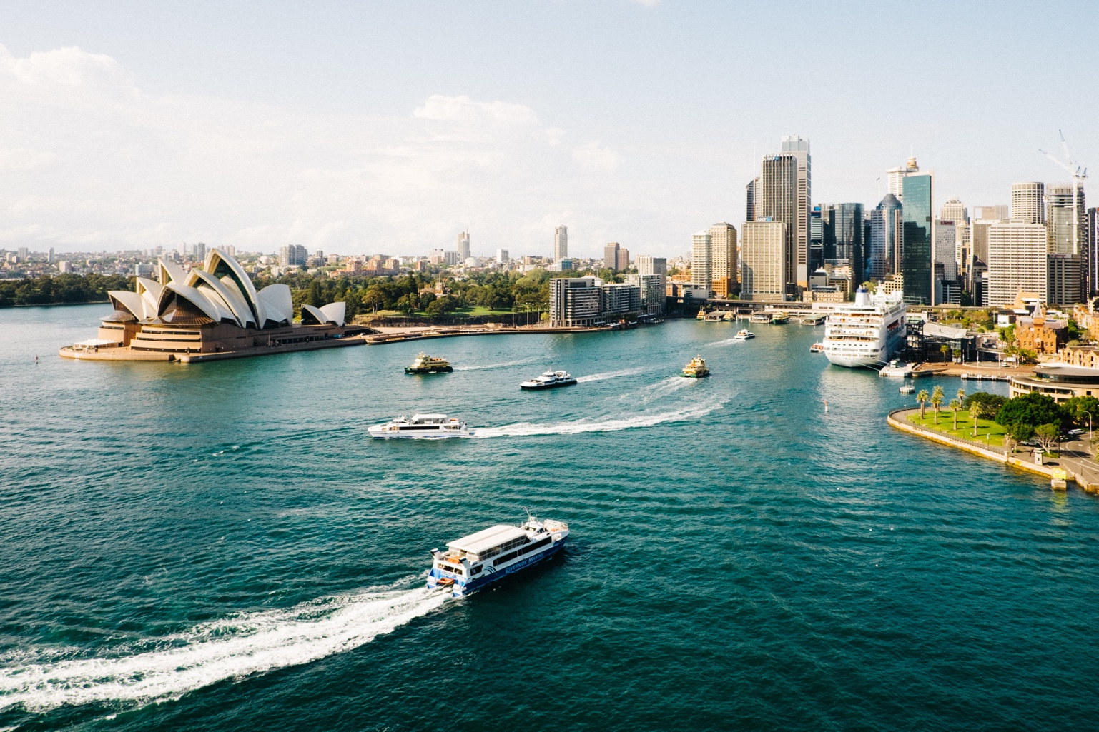
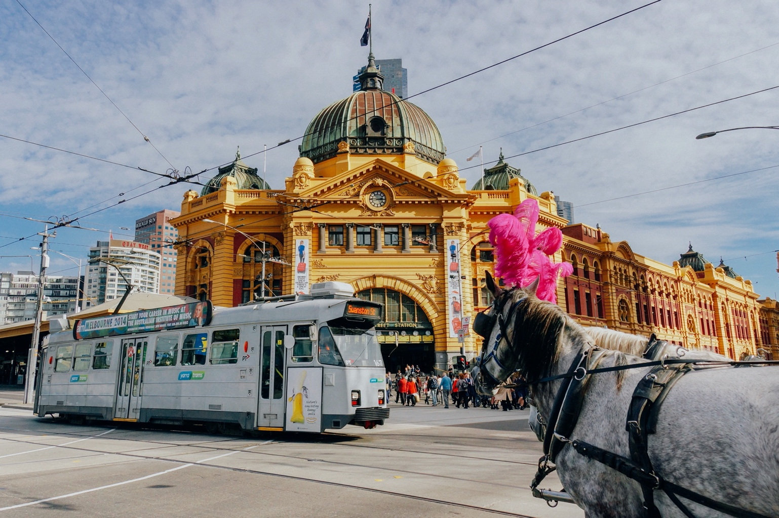
Rivals in Australia
Sydney
Melbourne

Slide 3
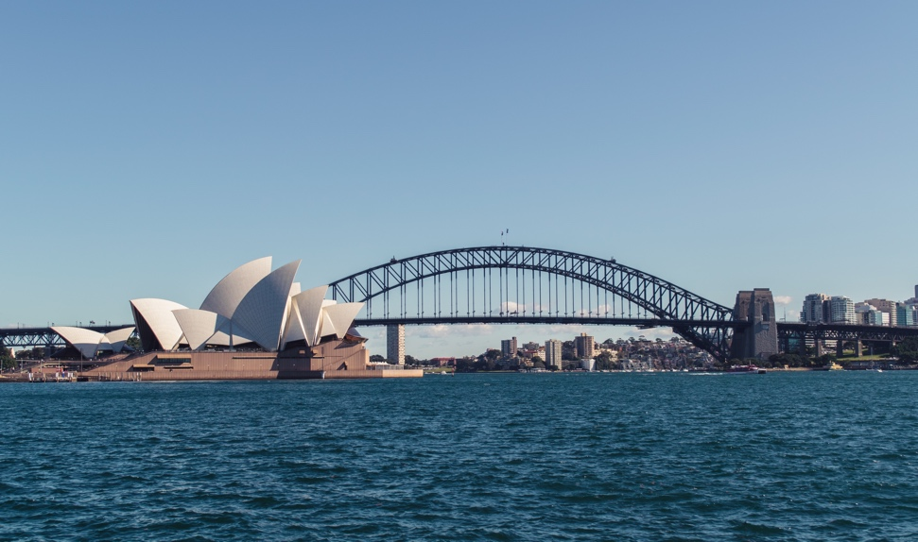

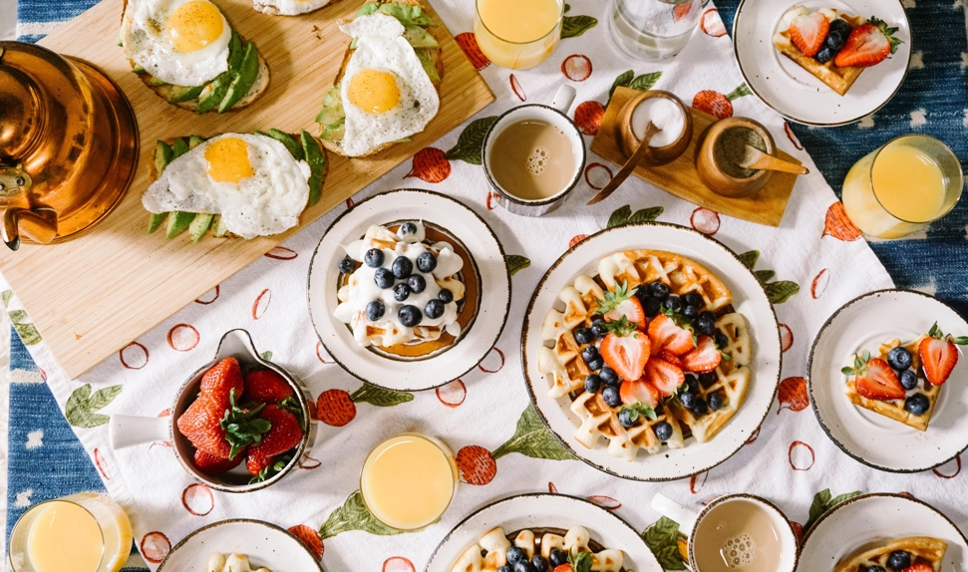
Sydney vs Melbourne
Sightseeing
Activities
Food
Attractions
Landscapes
Beach
Nightlife
???

Slide 4
Food Wars
Sydney
Melbourne
Diversity
High-class restaurants
Cultural
Hipster
Brunch
Coffee culture

Slide 5
A Guide For…
Tourists wanting to visit Australia
Australians to know what is in their backyard

Slide 6
Data
Acquisition and preparation

Slide 7
Location Data
Acquisition
Preparation
Australian Bureau of Statistics
2016 Census data
Suburb
Local government area
Region
State
Suburbs in Greater Sydney and Greater Melbourne extracted
Sydney: 915 suburbs
Melbourne: 560 suburbs

Slide 8
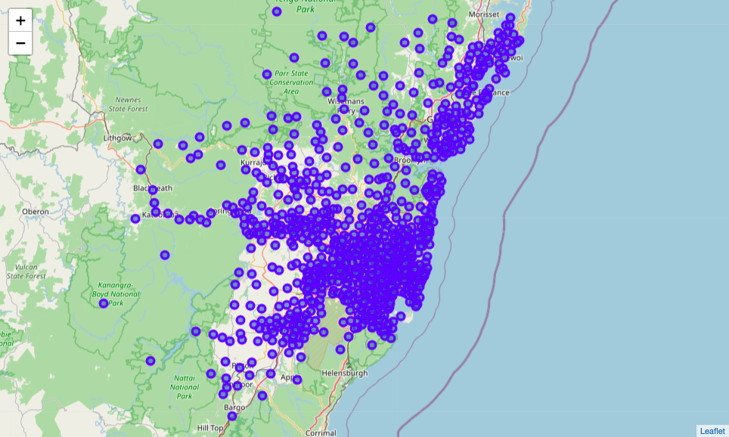
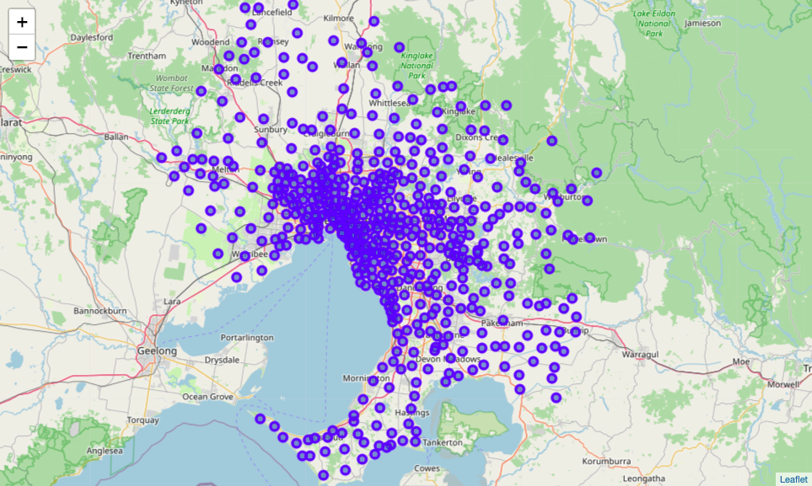
Location Data
Sydney
Melbourne

Slide 9
Venue Data
Acquisition
Preparation
Foursquare API
Search for venues within 500 m of suburb centre
Food venues only
Return venue name, coordinates, and category
Remove suburbs with less than 15 venues
Group venues within suburbs
Return top 3 venue categories of each suburb

Slide 10
Model
Implementation and Analysis

Slide 11
Cluster Model
Details
K-Means algorithm
5 clusters
Groups suburbs based on similar popular venue categories in each suburb

Slide 12
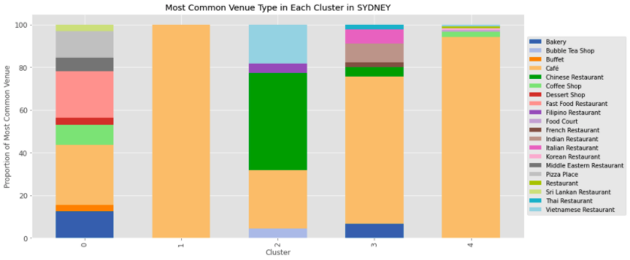
Sydney
Cuisines in each cluster
Cluster | Venues
0 | Take Away: Fast Food, Pizza, Middle Eastern
1 | Cafés
2 | Asian: Chinese, Vietnamese, Filipino
3 | European: French, Italian Asian: Indian, Thai
4 | Cafés Other Restaurants
0
1
2
3
4

Slide 13
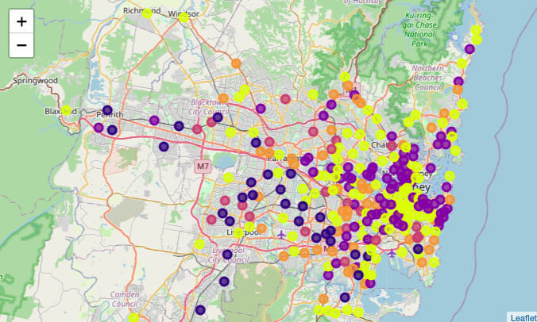
Sydney
Cluster locations
Take Away mostly in the west
Cafés mostly in the north and east
Asian, European throughout city
Cultural divide?

Slide 14
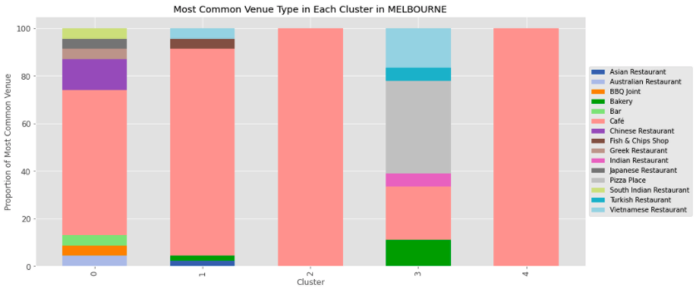
Melbourne
Cuisines in each cluster
Cluster | Venues
0 | Western: Australian, BBQ Asian: Chinese, South Indian
1 | Cafés Other Restaurants
2 | Cafés
3 | Pizza, Bakery, Vietnamese
4 | Cafés
0
1
2
3
4

Slide 15
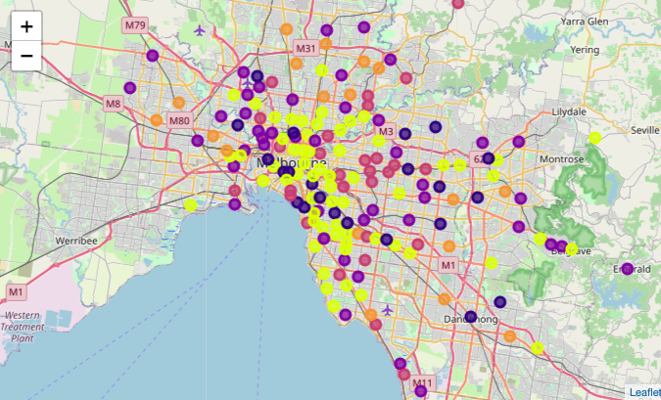
Melbourne
Cluster locations
Pizza, Bakery, Vietnamese in outskirts
All other clusters throughout city
Mostly clusters with cafés

Slide 16
Lessons

Slide 17
Conclusion
Sydney clusters are divided based on location
Demographic divide
Represents cultures and wealth diversity in Sydney
Sydney has many cafés in some areas, but Melbourne has many throughout the city
Sydney has more popular cuisines

